Slide 1
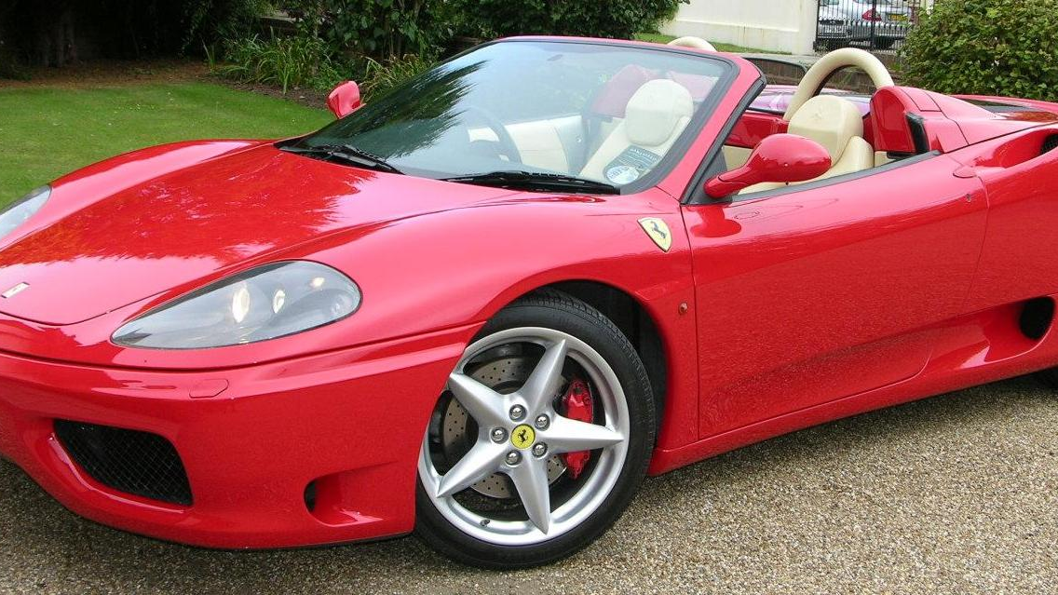
Top Cars in the World By Sri Sharan I
This Photo by Unknown Author is licensed under CC BY-SA

Slide 2

Agenda
Aston Martin DBX707
Audi e-tron S Sportback
Mercedes-Benz EQS 580 SUV
Porsche Taycan
Ferrari SF90 Stradale
Bugatti Chiron

Slide 3
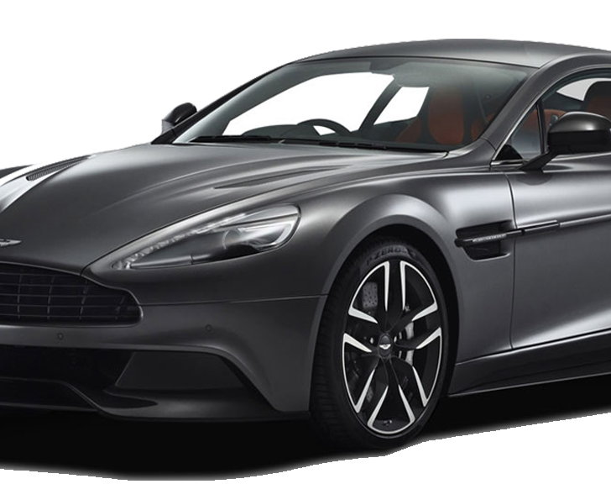
Aston Martin DBX707: This SUV boasts a 4.0-liter twin-turbocharged V8 engine, reaching 0-60 mph in just 3.1 seconds with a top speed of 193 mph. It’s a blend of sportscar agility and SUV practicality. Price starts at $236,000¹.

Slide 4
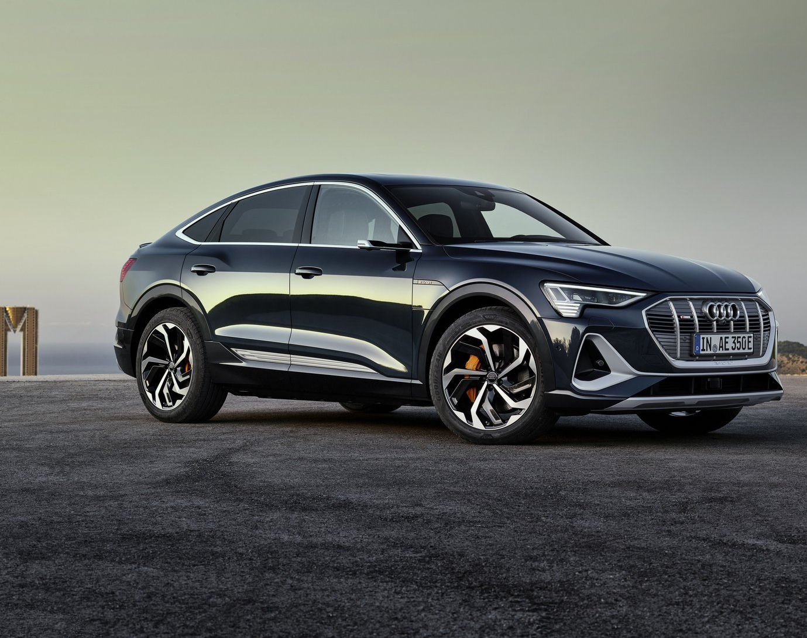
Audi e-tron S Sportback: With three distinct motors producing 370 kW, this electric SUV maintains Audi’s performance legacy without compromising power or agility.

Slide 5
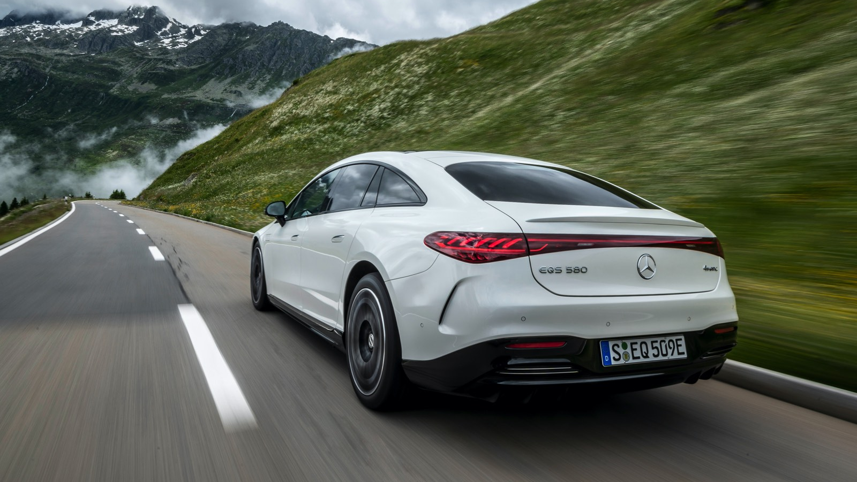
Mercedes-Benz EQS 580 SUV: An electric luxury SUV that redefines refinement, featuring cutting-edge technology and a focus on possibility.

Slide 6
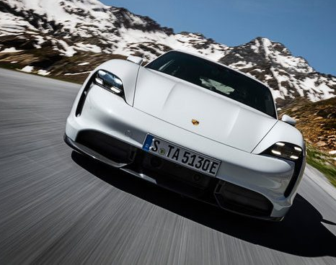
Porsche Taycan: A high-performance electric sedan with stunning design and impressive acceleration.

Slide 7
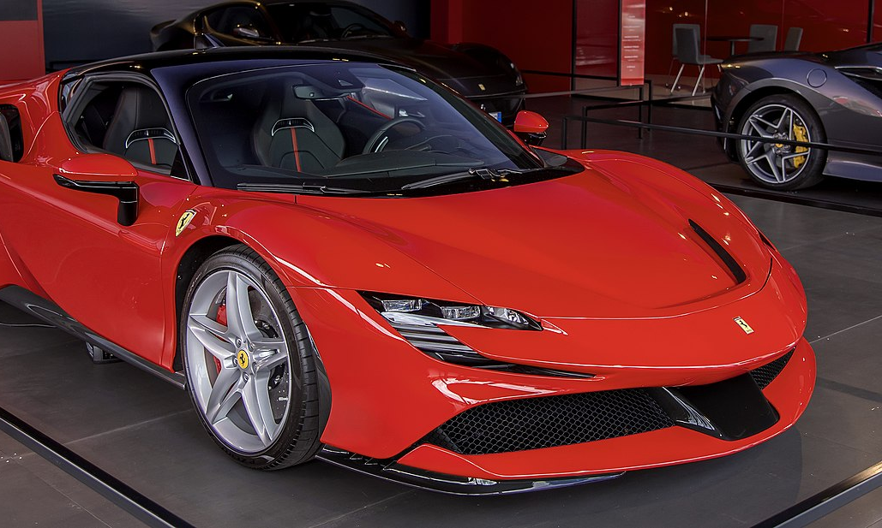
Ferrari SF90 Stradale: A hybrid supercar with a combined output of 986 hp, blending electric and gasoline power seamlessly.

Slide 8
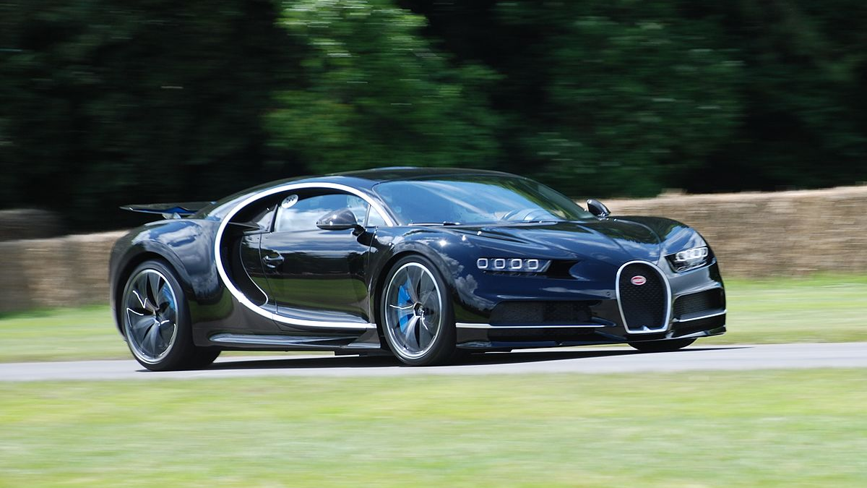
Bugatti Chiron: An engineering marvel with a quad-turbocharged W16 engine, reaching speeds over 300 mph.

Slide 9
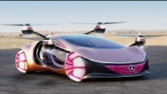

Slide 10
Thank You

